Slide 1
PLANT RECOMMENDATION MODEL FOR URBAN PEOPLE USING MAJORITY VOTING CLASSIFIER
Batch no: 18CSEC007
Date: 11th June 2022
Supervisor:
Smt. M. Anantha Lakshmi
Assistant Professor
V. Divya Priyanka 18K61A05G7
S. Nookambika 18K61A05D4
Sk. Imran Fazil 18K61A05E0
V. Sumanth 18K61A05H0

Slide 2
Table of Contents
Abstract
Problem Statement
Aim and Objective
Literature Review
Architecture
Methodology
Experimental Result
Conclusion and scope for future work
Contribution of the candidate
References

Slide 3
ABSTRACT
There is no scarcity of fresh air in villages and gardens but there is a vast necessity for pure air in cities. This proposed method aims to build a recommendation system for plants based on parameters for urban people using a decision tree algorithm which helps the gardeners to gain more interest in purifying the air We believe that the plants are natural air filters, if there are more plants then the amount of fresh air is produced is also more. The parameters considered in this model are the name of the plant, season, minimum and maximum temperature, minimum and maximum humidity, and the soil type is the growing conditions for plants. The dataset considered in this model is our customized dataset which consists of fruits, flowers, vegetables, and herbs. This recommendation model recommends the plants based on the user's input.

Slide 4
PROBLEM STATEMENT
People from villages do know well about plants but majority of the people who stay in cities and who have intentions to grow plants won't have enough knowledge of selection and classification of plants. The main challenge would be choosing the correct plant for the correct season. Having a habit of growing or maintaining a garden is good but the real challenge is how long the zeal of growing the plant species rest in minds if the situations are odd or against the suitable habitation.

Slide 5
AIM AND OBJECTIVE
The aim of this proposed method is to built a recommendation system for plants based on parameters.
The objective of this work is to provide information about plants and their growth in a specific season for the people who do not have any basic knowledge.
The main objective of this work is:
To pre-process the given data.
To train and test the model using decision tree algorithm.
To recommend plants based on input data.
Priorily, this work focuses on classifying and recommending the plant based on season. So, that it helps the mankind to grow the specific plant in particular season.

Slide 6
LITERATURE REVIEW
Recognition of Ayurvedic Medicinal Plants from Leaves, proposed by Amala Sabu et al. (2017) [11], discussed and implemented a system for automatic identification of medicinal plants from their leaves.
Created their own dataset for experiments since a standard data set is not available in the domain.
Identification of medicinal plants from their leaves which makes use of OpenCV and machine learning.
The demerits of this model is the leaf dataset considered is small and instead of using K-NN classifier, using SVM or ANN classifier gives better result.

Slide 7
LITERATURE REVIEW CONTD..
Plant Species Identification by using Scale Invariant Feature Transform and Grid Based Colour Moment by Nuril Aslina Che Hussin.
The dataset focuses on 126 tree species from French Mediterranean area which contains 11572 pictures.
This paper presents a method of shape feature extraction that is Scale Invariant Feature Transform (SIFT) and colour feature extraction Grid Based Colour Moment (GBCM) to identify plant.
Plant Classification Using Artificial Neural Networks by Luciano D.S. Pacifico.
In this work, they used a Multi-Layer-Perceptron (MLP) artificial neural network trained with Back propagation algorithm to perform automatic plant classification.
Three real-world plant data sets obtained from UCI Machine Learning repository are employed: Iris, Wheat Seeds and 100 Plant Leaves. 100 Plant Seeds data set.
The demerits of this model is the dataset used consists of only iris, wheat seeds and 100 plant leaves of same plant i.e. dataset is limited.

Slide 8
LITERATURE REVIEW CONTD..
Plant Species Identification Using Leaf Image Retrieval by Neha Goyal.
The dataset considered was Flavia dataset.
Recommended various feature extraction approaches, classification, and other difficulties are used to identify plant species.
Furthermore, the precision, recall, and F-Score of two widely used classifiers, Support Vector Machine (SVM) and Probabilistic Neural Network (PNN), are evaluated.
It was concluded from the review that the majority of studies are based on leaf shape and edge.
The demerits of this model are it does not work well with larger dataset.
Features of leaves are not included which is recognition of identification

Slide 9
LITERATURE REVIEW CONTD..
Combined Classifier for Plant Classification and Identification from Leaf Image Based on Visual Attributes by Parul Mittal.
They discussed about the improved performance of the combined classifier technique for the classification and identification of plant leaf images.
The research technique shows how to extract features such as shape, colour, texture, and vein.
There was a total of 139 characteristics retrieved, which were then classified and identified using various classifiers such as SVM, Decision tree, and combination classifier.
The demerits of this model is method doesn’t include all physical attributes.

Slide 10
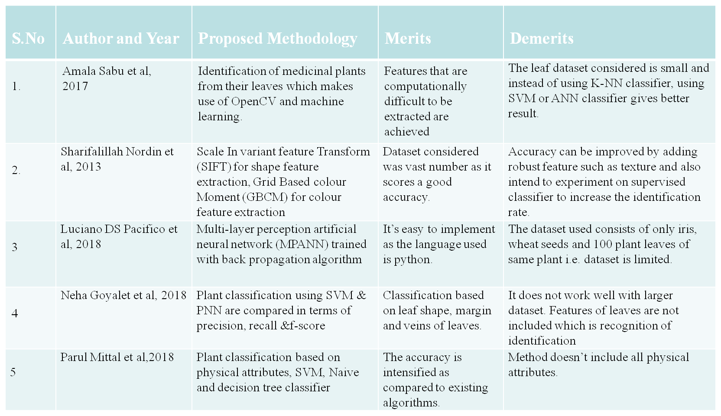
LITERATURE REVIEW CONTD..

Slide 11
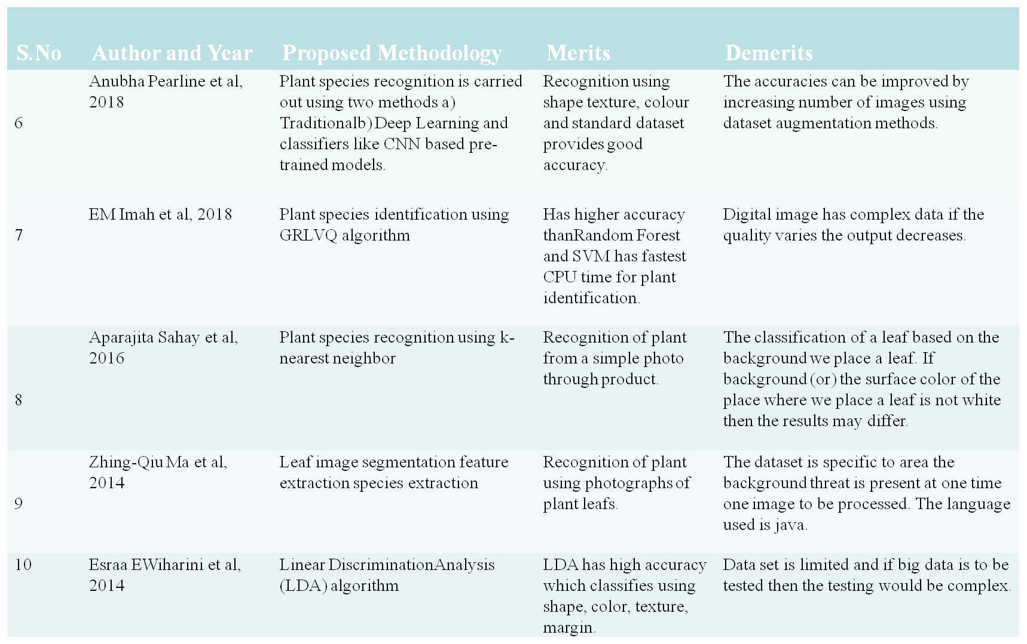
LITERATURE REVIEW CONTD..

Slide 12
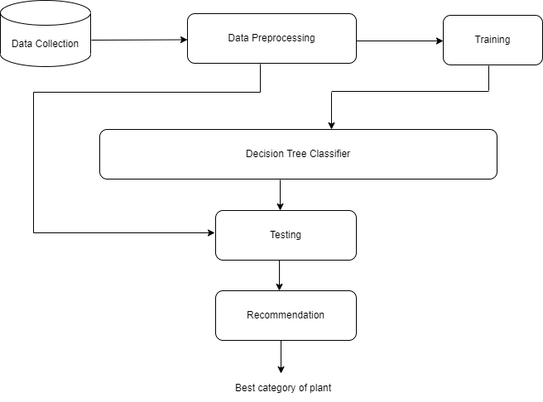
ARCHITECTURE
Figure 1: System Architecture

Slide 13
METHODOLOGY CONTD..
In the proposed methodology there are two phases: prediction and recommendation system.
In the prediction phase the best category of plant is obtained for the given conditions and in the recommendation phase for the given conditions in the input related plants names, type of soil are obtained.
The dataset considered in this model is our own customized dataset.
The parameters in the dataset are minimum and maximum temperature, minimum and maximum humidity, season and soil type.

Slide 14
METHODOLOGY CONTD..
The flow of execution takes place as
Dataset creation
Pre-processing of data
Prediction of plant category
Recommendation and classification model

Slide 15
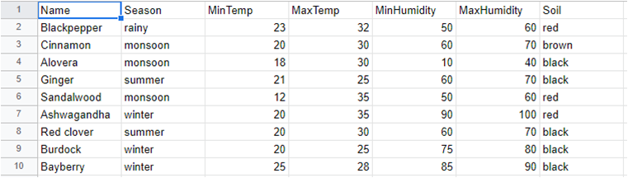
METHODOLOGY CONTD..
1. Dataset Creation
The dataset considered in this model is our own customized dataset of 1340 species. It contains fruits, flowers, vegetables and herbs. The parameters considered in the dataset are name of the plant, season, minimum and maximum temperature, minimum and maximum humidity, and soil type.
Figure :2 Dataset(First 10 values are shown)

Slide 16
METHODOLOGY CONTD..
2. Data Pre-processing
Data preprocessing is the procedure for preparing raw data for use in a machine learning model.
It's the first and most important stage in building a machine learning model.
preprocessing is divided into four stages:
data cleaning
data integration
data reduction
data transformation.

Slide 17
METHODOLOGY CONTD..
Decision Trees usually mimic human thinking ability while making a decision, so it is easy to understand.
The logic behind the decision tree can be easily understood because it shows a tree-like structure.
Decision trees use multiple algorithms to decide to split a node into two or more sub-nodes.
The creation of sub-nodes increases the homogeneity of resultant sub-nodes.
In other words, we can say that the purity of the node increases with respect to the target variable.
The decision tree splits the nodes on all available variables and then selects the split which results in most homogeneous sub-nodes.

Slide 18
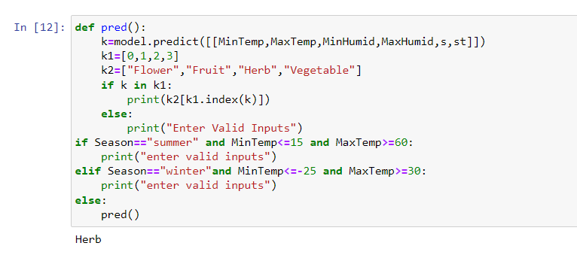
EXPERIMENTAL RESULTS
Figure : Prediction of plant category

Slide 19
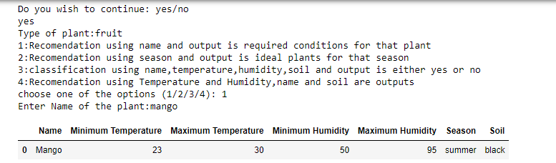
EXPERIMENTAL RESULTS CONTD..
Figure : Recommendation using name and output is required conditions for that plant

Slide 20
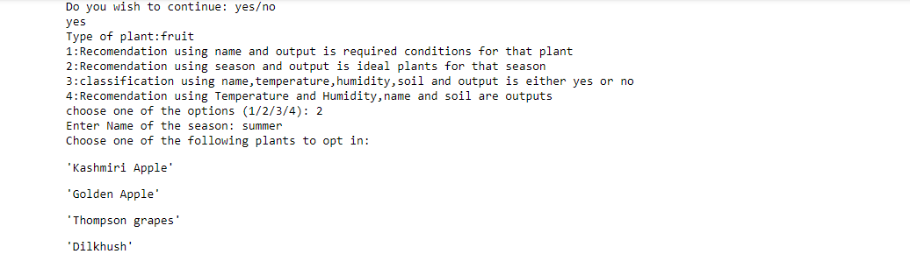
EXPERIMENTAL RESULT CONTD...
Figure : Recommendation using season and output is ideal plants for that season

Slide 21
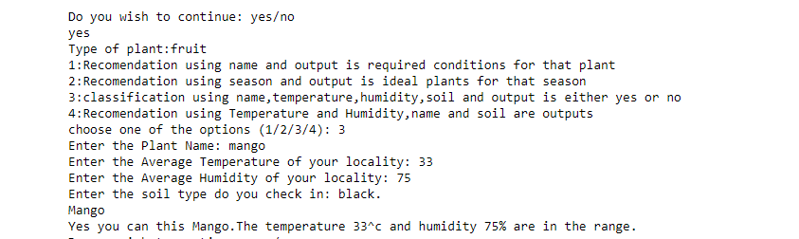
EXPERIMENTAL RESULT CONTD..
Figure : Classification using name, temperature, humidity, soil and output is either yes or no

Slide 22
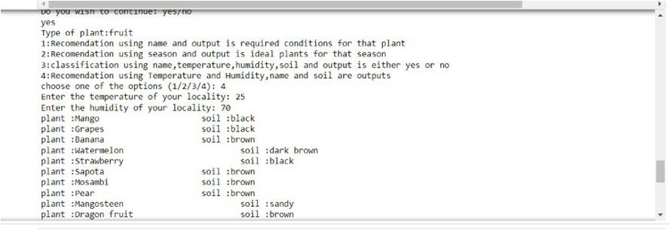
EXPERIMENTAL RESULT CONTD..
Figure : Recommendation using temperature and humidity, name and soil are outputs

Slide 23

EXPERIMENTAL RESULT COTND..
Figure : Accuracy of the model

Slide 24
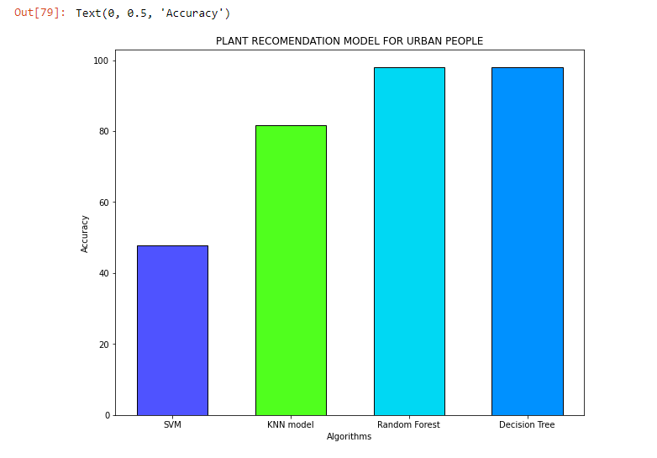
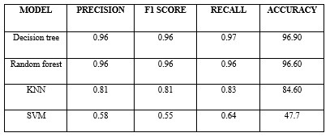
EXPERIMENTAL RESULTS CONTD..
Table : Evaluation metric values comparison
Figure : Comparison of models

Slide 25
CONCLUSION AND SCOPE FOR FUTURE WORK
This project “Plant Recommendation Model for Urban People” is cost-effective, eco-friendly, practical for recommending plants.
Four types of classifiers are compared, namely Decision Tree, Support Vector Machine, Random Forest and K-Nearest Neighbour are implemented in this project.
This model is able to predict the best category of plant and gives different recommendations to grow the plant based on the input.
This model obtained the accuracy of 96.9% when tested with Decision Tree classifier and gives the best results when compared with other classifiers.
The Plant Recommendation Model is useful for people who do not have any kind of knowledge to grow the plant and also recommends the user with the best category of plant to grow.
In future, this project can be extended using a large data set. The dataset currently used for implementation includes 1300 records, which can be increased to get better results. Additional parameter such as user’s locality can be added. If the growth of the plant is not up to the mark then soil testing can be included to provide high end results.

Slide 26
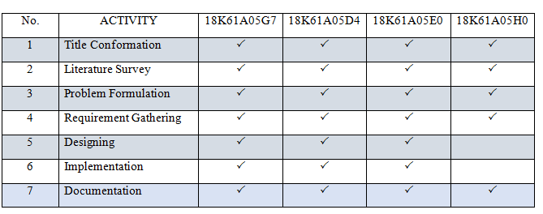
CONTRIBUTIONS OF THE CANDIDATE

Slide 27
REFERENCES
Amala Sabu, Sreekumar K, Rahul R Nair, “Recognition of Ayurvedic Medicinal Plants from Leaves: A Computer Vision Approach”, IEEE, 2017.
NurilAslina Che Hussin, Nursuriati Jamil, SharifalillahNordin, Khalil Awang,“ Plant Species Identification by using Invariant Feature Transform (SIFT) and Grid Based Colour Moment (GBCM)”, IEEE, 2013.
Luciano D.S. Pacifico, ValmirMacario, Joao F.L. Oliveria, “Plant Classification Using Artificial Neural Networks”, IEEE, 2018.
Neha Goyal, Kapil, Nitin Kumar, “Plant Species Identification using Leaf Image Retrieval: A Study”, IEEE, 2018.
Parul Mittal, Manie Kansal, Hardeep Kaur, “Combined Classifier for Plant Classification and Identification from Leaf Image based on Visual Attributes”, IEEE, 2018.

Slide 28
THANK YOU!

